Slide 1
Testing LINe Prepared dataset for CIFAR experiment In-distribution Data – CIFAR 10 and CIFAR 100 Out-distribution data – Textures, LSUN-C, LSUN-R, LSUN-resize and iSUN Prepared pre trained models Densenet checkpoint_100.pth for CIFAR-10 and CIFAR-100
Precomputing for calculate Shapley value approximation – precompute.py
Testing demo code for CIFAR experiment – demo-cifar.sh
Testing
Set up pytorch conda environment locally
Tested on Colab Notebook

Slide 2
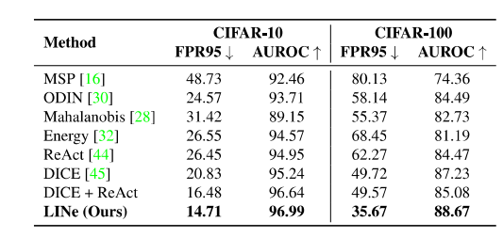
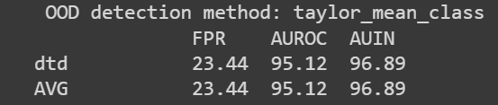
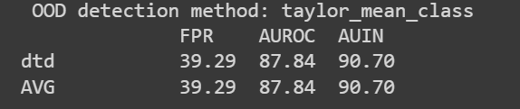
Testing on Colab Notebook
In-distribution dataset – CIFAR10 and CIFAR-100
Out-distribution dataset - Textures
Results Experiment result
CIFAR-10
CIFAR-100

Slide 3
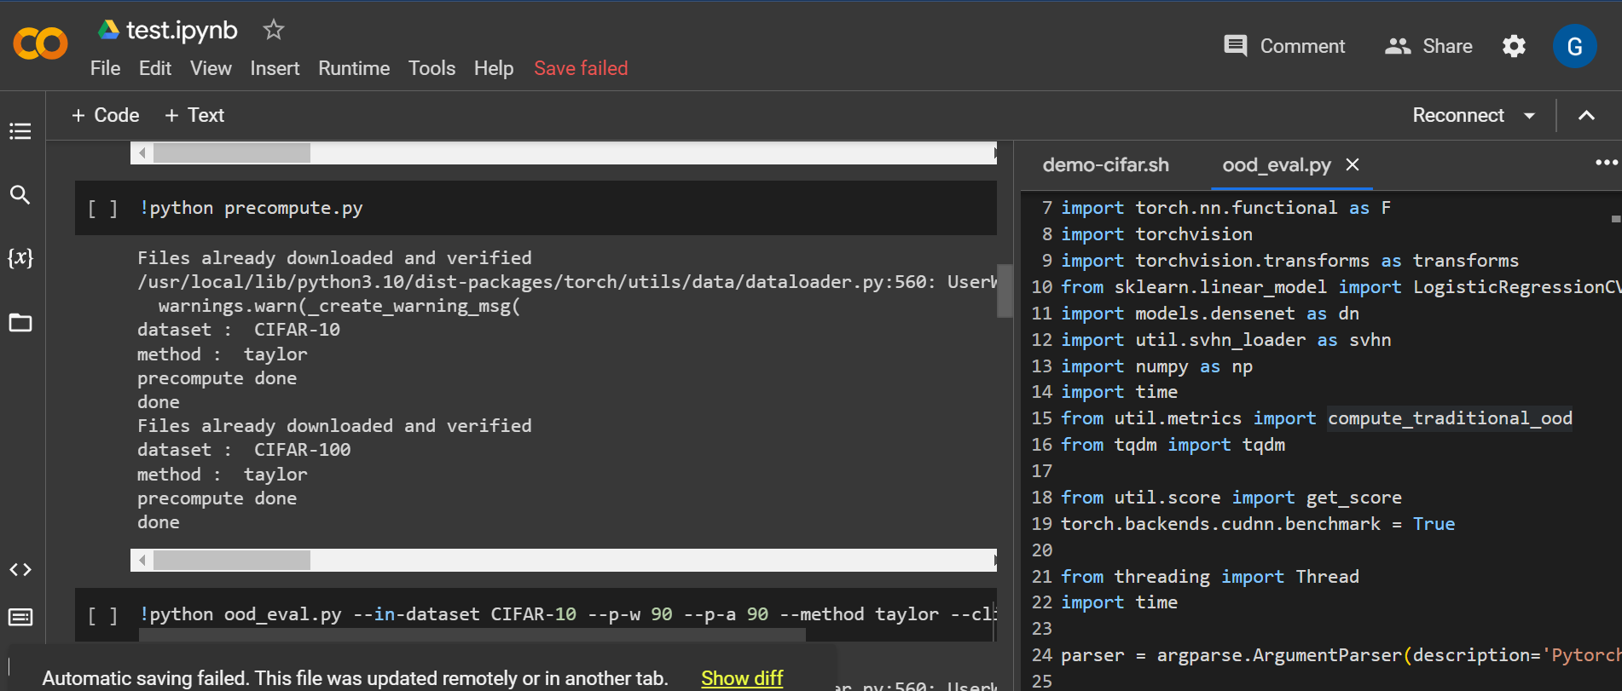
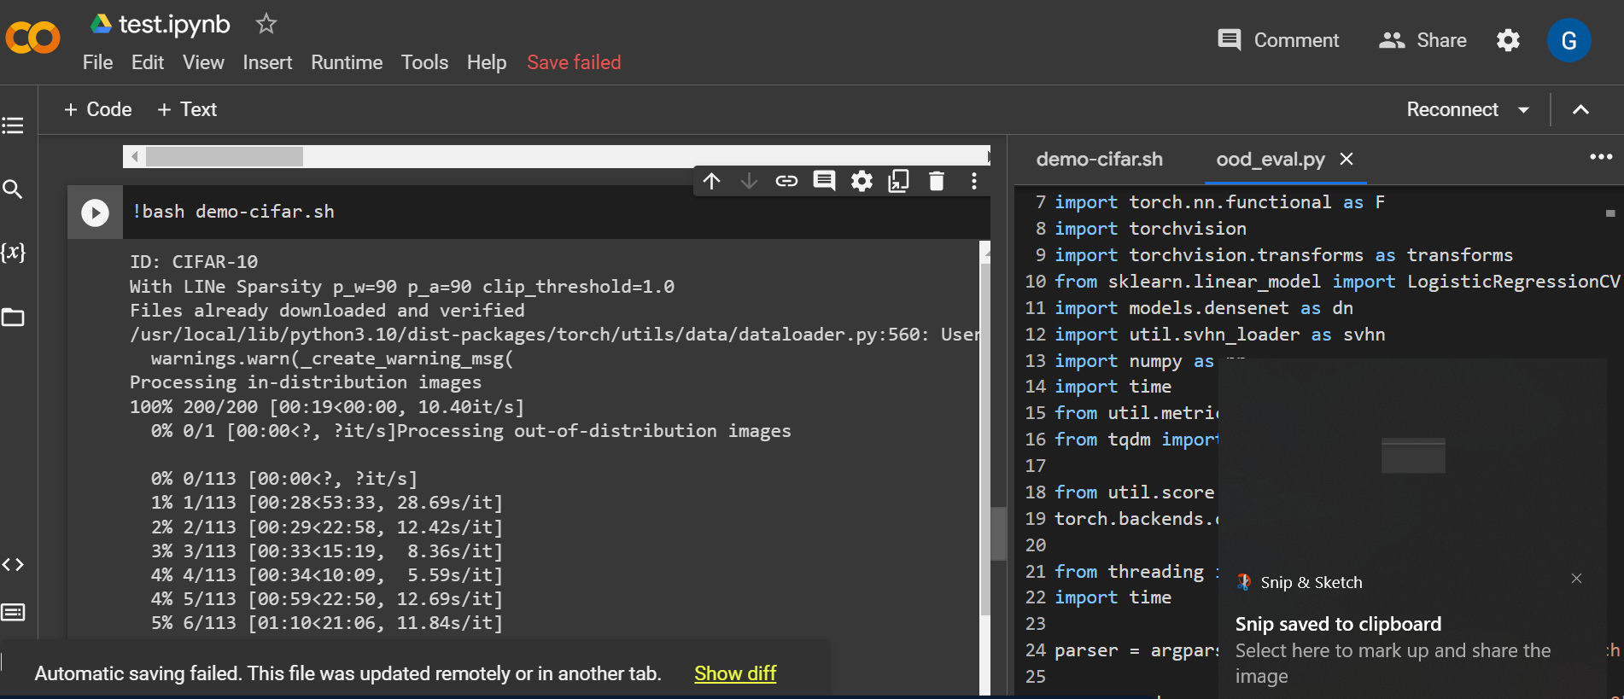
Testing on Colab Notebook
In-distribution dataset – CIFAR10 and CIFAR-100
Out-distribution dataset - Textures

